Slide 1




Cardiac Patients Medical Report Analysis

Slide 2
Table of contents
Introduction
01
02
Goals & KPIs
03
Recommended
Analysis
04
Conclusion
PROBLEM STATEMENT
BACKGROUND

Slide 3
Introduction
BACKGROUND & PROBLEM STATEMENT:-
Heart attacks are a leading cause of premature mortality globally, with India witnessing over 3 million deaths annually due to heart attacks and strokes. Numerous factors can impact heart health and efficiency. By gaining valuable insights and taking necessary precautions, we can effectively manage the challenges and complications associated with cardiac health.

Slide 4

SOLUTION:-
In this study, we conducted a detailed analysis of medical reports from numerous heart patients. The goal was to perform exploratory analysis, uncover significant findings, and process the dataset for potential use in machine learning models. Ultimately, these models could aid in predicting the likelihood of heart attacks in new patients.
By conducting this in-depth analysis, we hope to contribute to the advancement of medical knowledge, enhance patient care, and improve outcomes for individuals at risk of cardiac issues.

Slide 5

PROJECT SCOPE & METHODOLOGY:-
The primary objective of this project is to analyze cardiac patient medical reports using Excel tools to derive insights, trends, and patterns that can aid in medical decision-making, patient management, and research.
Gather a comprehensive dataset of cardiac patient medical report.
Preprocess the data to handle missing values, outliers, and inconsistencies.
Utilize Excel tools such as PivotTables, PivotCharts, and advanced functions for data manipulation and analysis.
Explore correlations between different variables such as age, gender, risk factors, and medical outcomes.

Slide 6
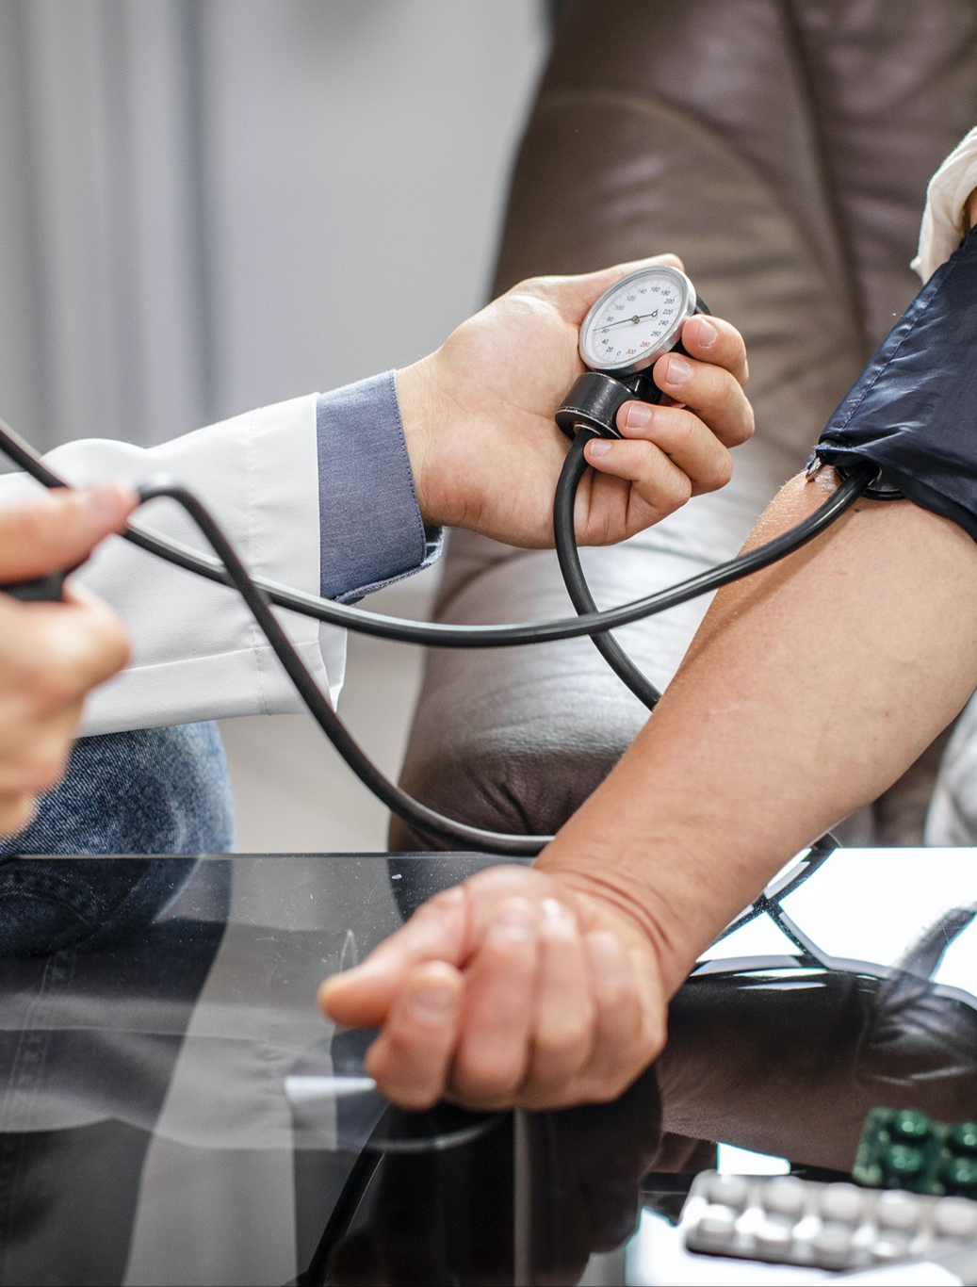
6. Develop risk stratification models to categorize patients based on their likelihood of developing cardiac events (e.g., heart attacks, strokes).
7. Visualize risk stratification results using Excel charts to facilitate interpretation and decision-making.
8. Employ Excel's comparative analysis tools to identify optimal treatment strategies for specific patient subpopulations.
9. Create visually appealing dashboards and reports using Excel's charting and formatting capabilities.
10. Present key findings, insights, and recommendations in a clear and concise manner.
11. Incorporate interactive elements (e.g., slicers, filters) into Excel dashboards to enable users to explore data dynamically.

Slide 7

GOALS & KPIs:-
The overarching goal of this project is to leverage Excel tools to analyze cardiac patient medical reports comprehensively.
KPIs:-
Measure of heart attack
Cholestrol Level
Resting blood pressure
Fasting blood sugar level
Maximum heart rate achieved

Slide 8
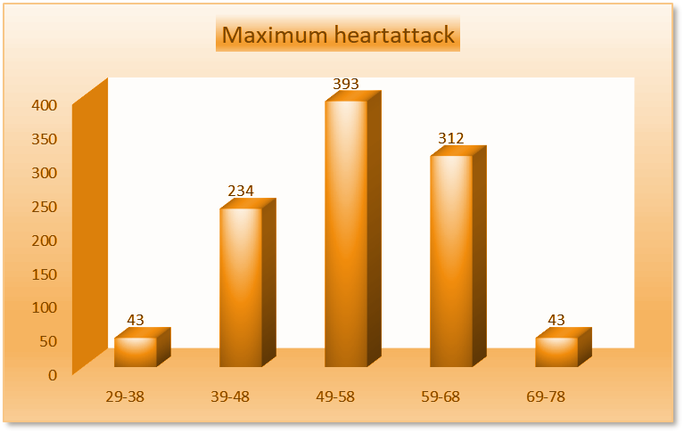
RECOMMENDED ANALYSIS:-
1. What age group is most vulnerable or has a large number of patients with a higher risk of heart attack?
From this barchart we can see the age group between 49-58 has a large number of patients with a higher riskk of heart attack.

Slide 9
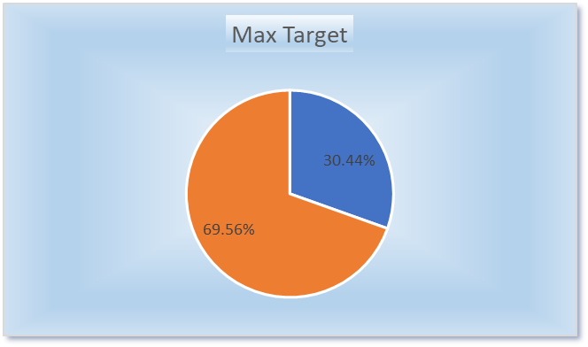
2. Are men mostly prone to heart attacks or women?
As compared to women,men are mostly prone to heart attacks which comprises 69.56%.

Slide 10
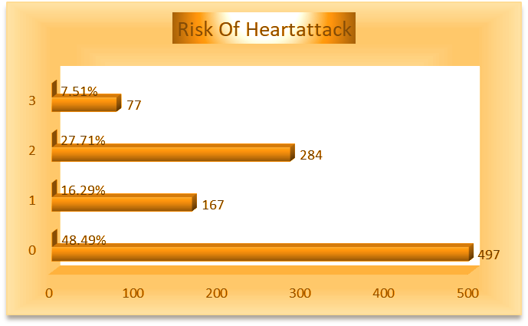
3. What chest pain types pose a severe risk of a heart attack?
Out of the 4 , typical angina poses a severe risk of heart attack.

Slide 11
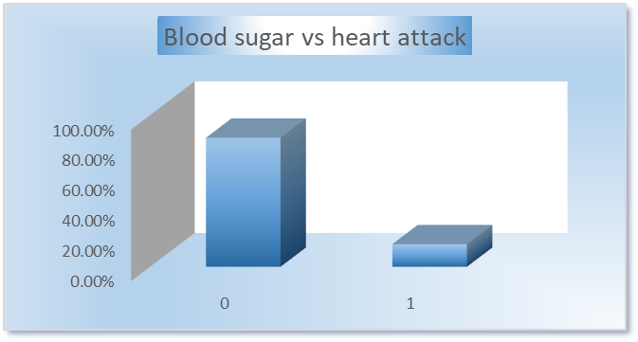
4. How fasting blood sugar is related to heart attack?
Here fasting blood sugar is not directly related to heart attack as we can see 85.07% of people don’t have fasting blood sugar yet experienced heart attack and 14.93% of people having fasting blood sugar don’t have the risk of heart attack.

Slide 12
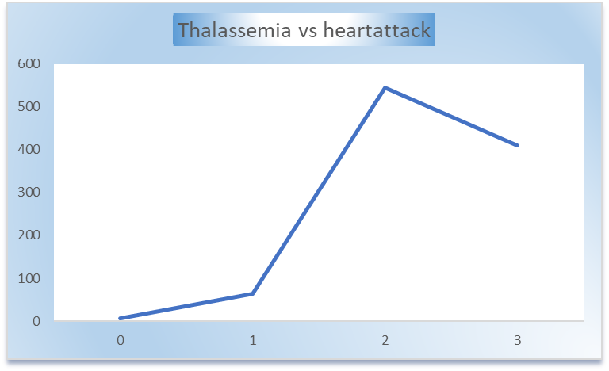
5. What type of thalassemia severely leads to heart attack?
Category 2 type of thalassemis severely leads to heart attack

Slide 13
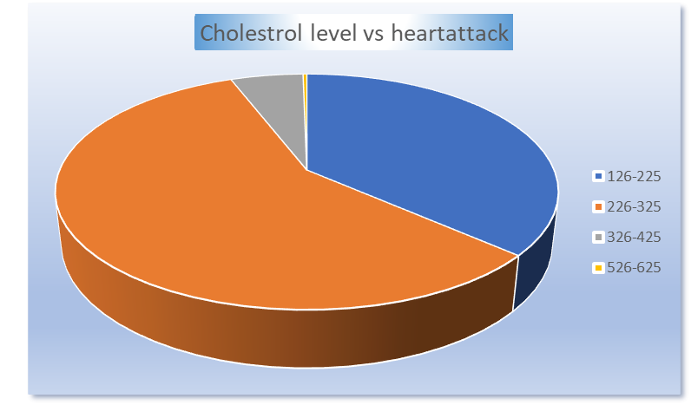
6. Due to cholesterol, how many patients are at higher risk?
Here cholestrol level is not directly related to heart attack.
As we can see people having higher cholestrol level they are less
prone to heart attack as compared to people having lower cholestrol
level.

Slide 14

CONCLUSION:-
In summary, using Excel to analyze medical reports of heart patients gives us important information about how the disease works, how well treatments work, and how patients are doing. This helps doctors choose the best treatments for each patient, making care better. This project also helps researchers learn new things about heart problems and treatments. By working together and improving our methods over time, we can make heart care better, reduce the impact of heart diseases, and make life better for heart patients everywhere.

Slide 15



THANK YOU!
PROJECT OWNER: MUSHKAN SAH
EMAIL ID: muskaansah2000@gmail.com
LINKEDIN: https://www.linkedin.com/in/mushkan-sah-m200017
PEERLIST:https://peerlist.io/mushkan17

